Slide 1
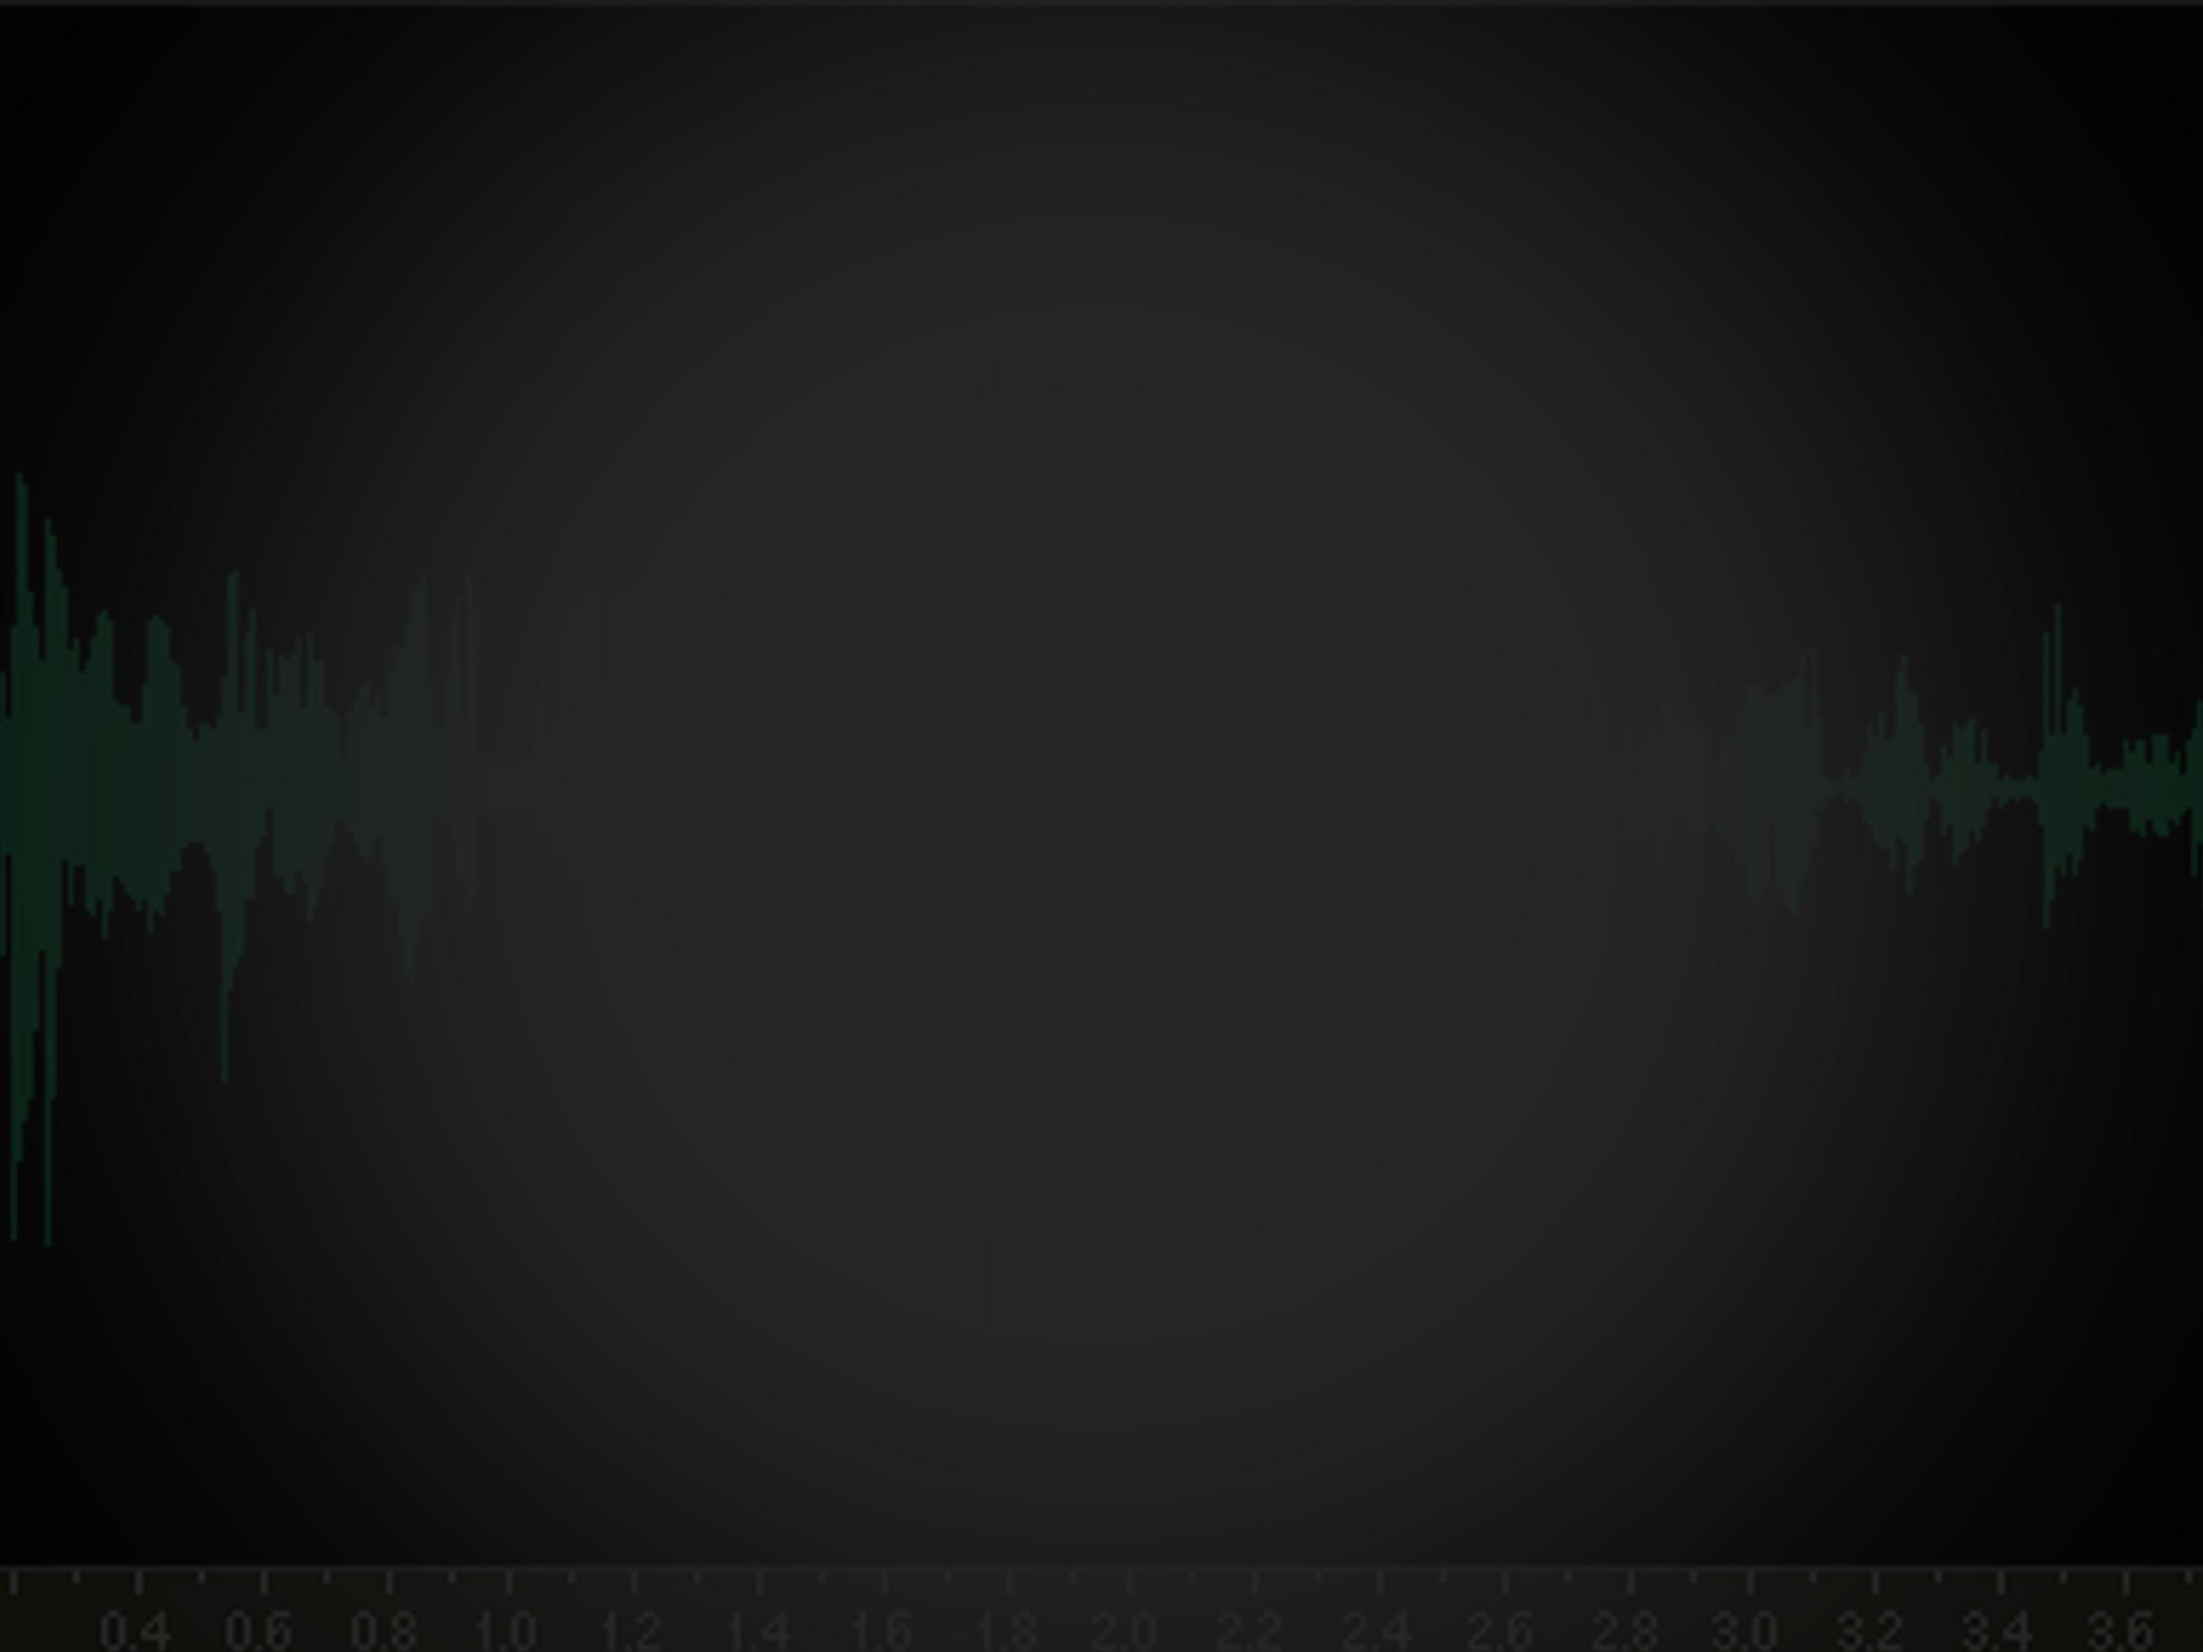
Network Audio
Data Transfer
Andy Jarombek

Slide 2
The Problem
How to Send Audio Data From Client to
Server
How do Users React to Changes in Loss and
Delay

Slide 3
Presentation Topics
The Final Java Code
The Coding Process
The Experiment
Experiment Results
Conclusion

Slide 4
The Code
Reading Audio Data on Client Machine
Sending UDP Packets Containing Audio Data
Play Audio Data on Server Machine
Each Machine Will Run Both Client & Server

Slide 5
Machine 1
Machine 2
AudioClient
AudioClient
AudioServer
AudioServer
Port #
12345
Port #
12345
IPv4: 10.70.2.108
IPv4: 10.60.15.92
Send Packet To: Port 12345, IP 10.60.15.92
Send Packet To: Port 12345, IP 10.70.2.108

Slide 6
The Code
Audio (Main Thread)
Audio Client
Audio Server
Simulate

Slide 7
Audio Class
public static void main(String[] args) {
MyAudio myAudio = new MyAudio(SAMPLE_RATE, SAMPLE_SIZE);
String IP = args[0];
double lossRate = Double.parseDouble(args[1]); // 0.0 - 1.0
int sampleInterval = Integer.parseInt(args[2]); // in ms
AudioServer audioServer = new AudioServer(sampleInterval,myAudio);
AudioClient audioClient = new AudioClient(sampleInterval,lossRate,IP,myAudio);
Thread server = new Thread(audioServer);
Thread client = new Thread(audioClient);
server.start();
client.start();
}

Slide 8
Coding Process
Implement UDP Transfer Similar to HW2
Add Audio Components
Simulate Loss and Delay (Packet Size)
Remove Unnecessary Features
Add Threading
Deal with School Computers

Slide 9
The Experiment
Test the Code with 10 Different Individuals
Simulate Different Levels of Loss and Delay
(16 Different Combinations)
Have Participants Rate Audio Quality
on a Scale from 1-5

Slide 10
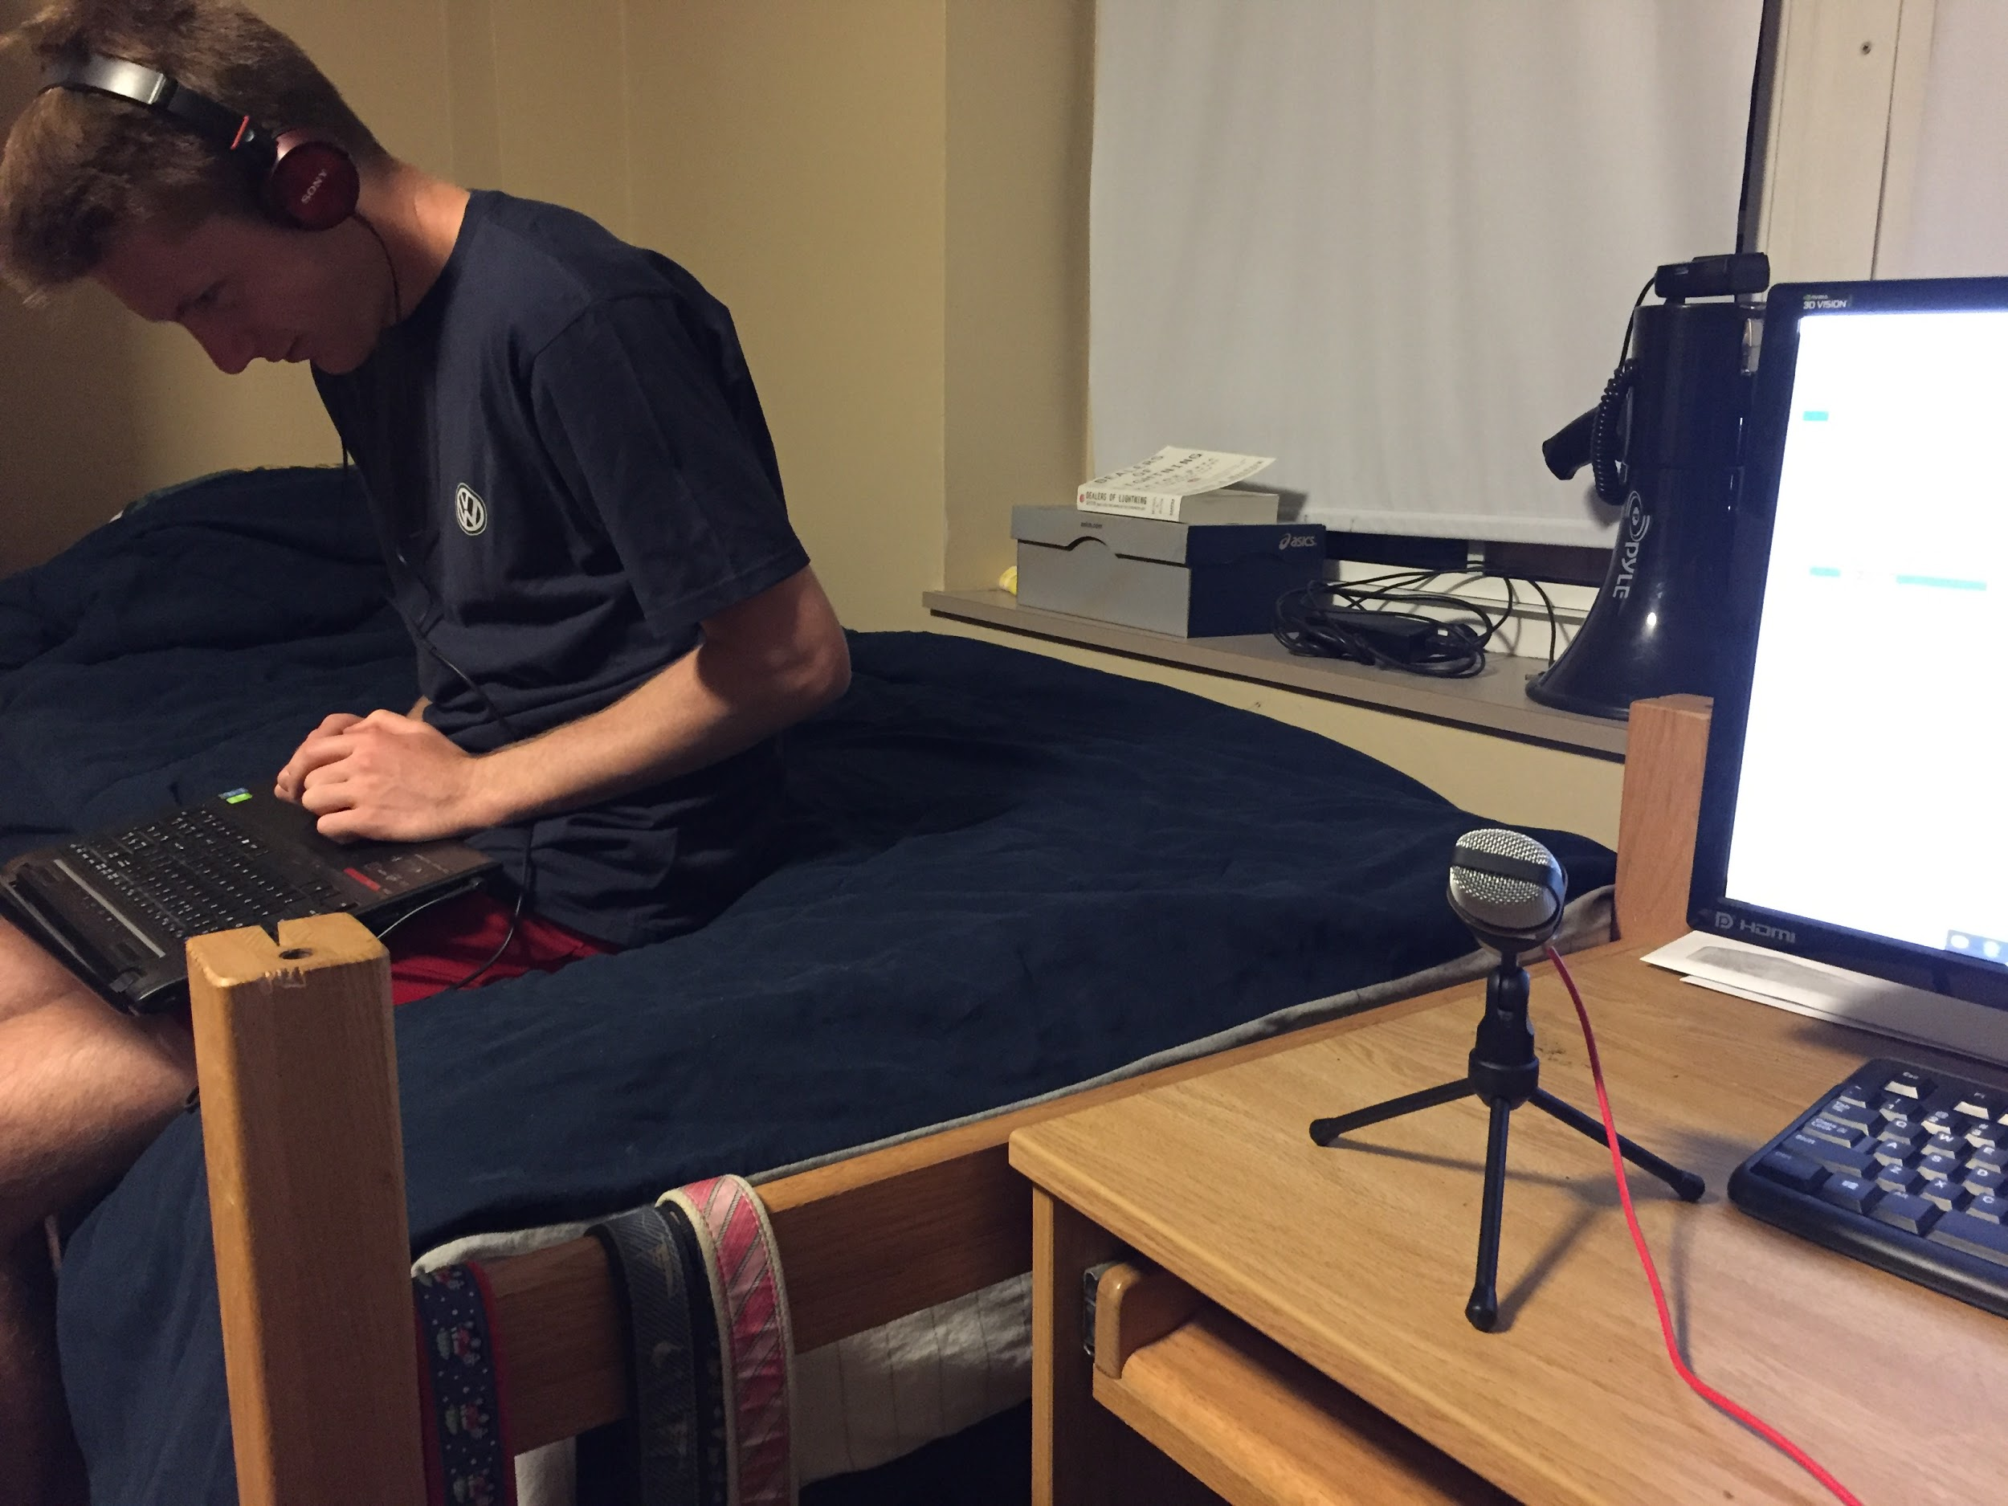
Experiment Setup Picture

Slide 11
Experiment Results
Steep Drop-Off In Quality
People were more accepting of delay than loss*
*A few people really hated any delay

Slide 12
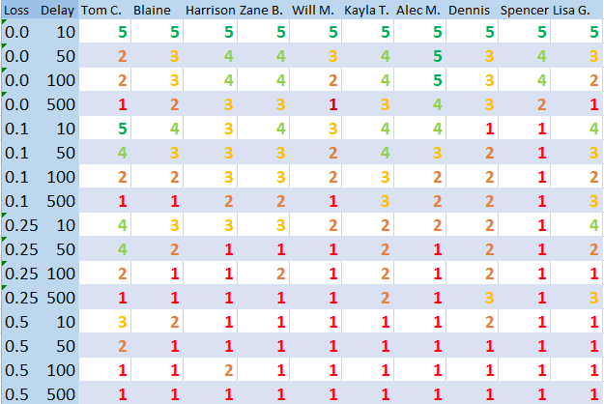
Table of all Data results

Slide 13
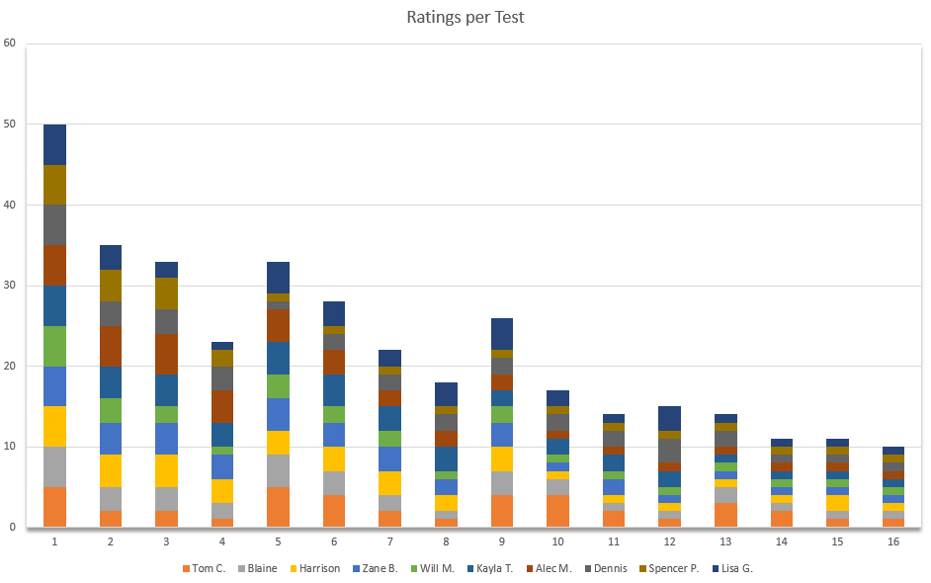
Graph of all data results

Slide 14
Some Fun Results
60% Of Participants gave 50% loss and 500ms
delay a score below a 1.
3 Participants Said I ruined their day by putting
them through my experiment.
Fifteen 0’s, one -1, and two -2’s were scored by seven different participants

Slide 15
Conclusions
It is very easy to annoy customers with
poor audio quality.
The Drop off between “good” and “bad”
audio quality was steep

